Slide 1

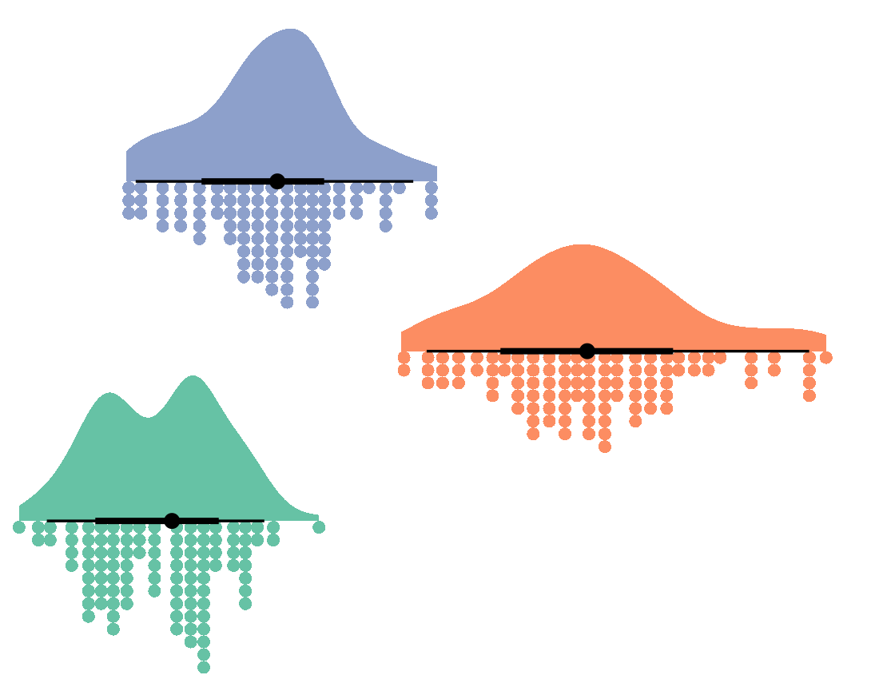


Welcome to
Cleaning and analysis
Joseph M Barnby
11/01/2023
Postgraduate Lectures
Twitter: JoeBarnby
Mastodon: @joebarnby@mastodon.online

Slide 2
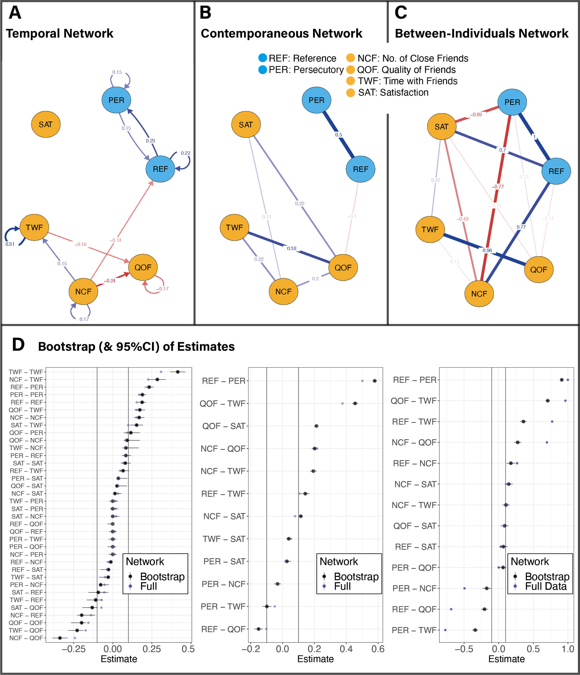
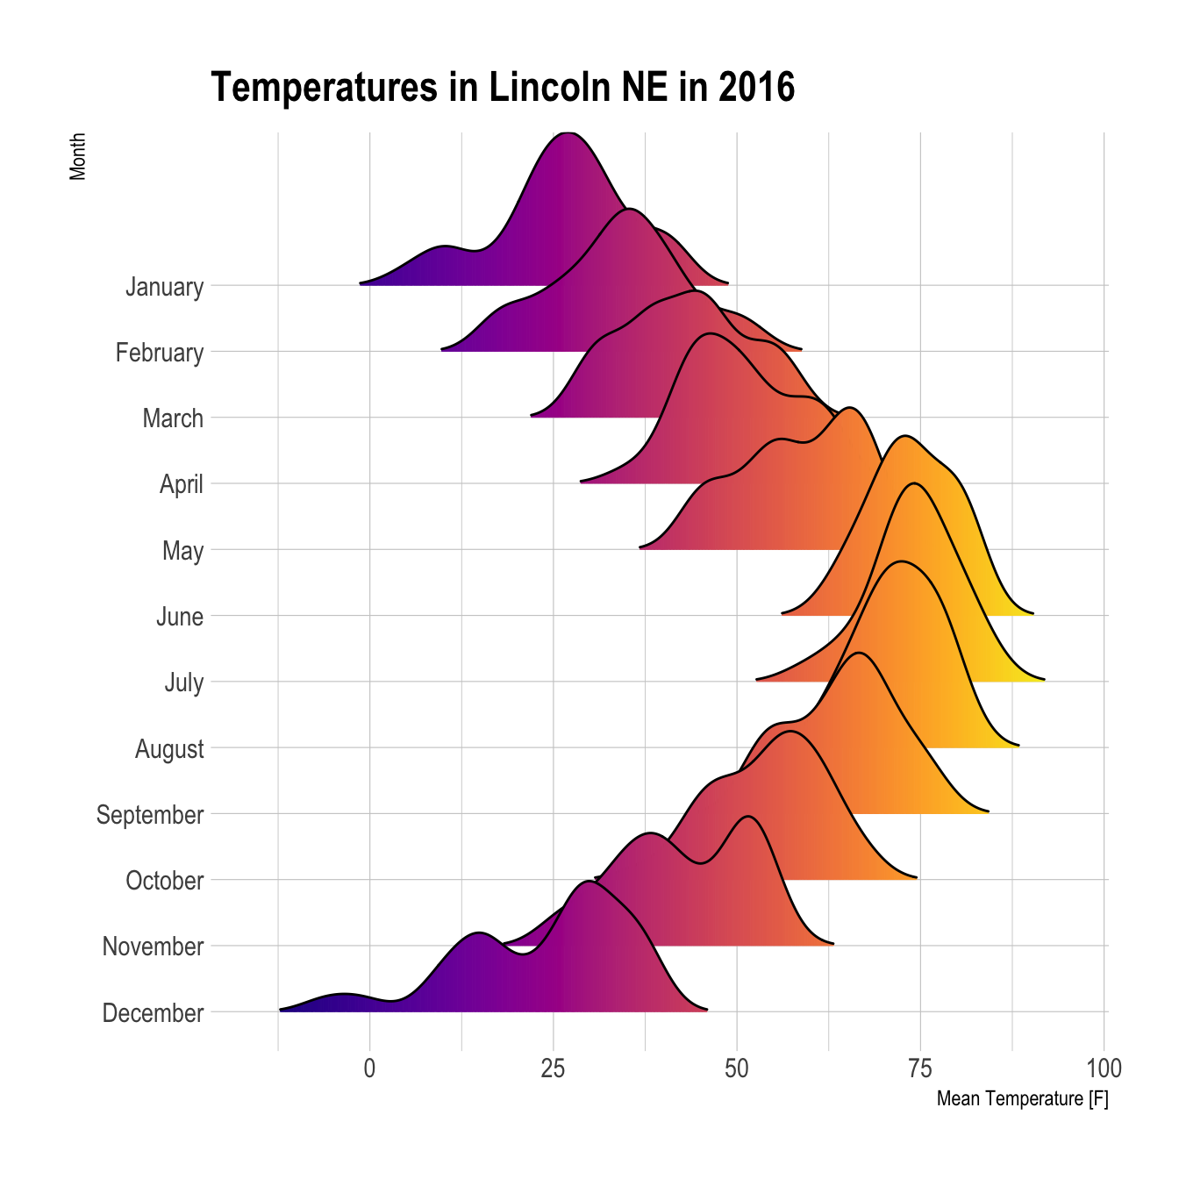


The three lectures
Getting things going (today)
Cleaning your data (11/01/2023)
Making beautiful plots and figures (25/01/2023)

Slide 3
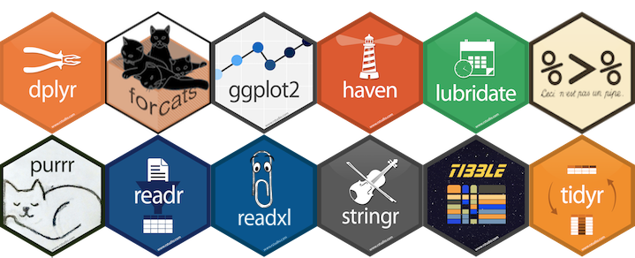
R is an open source language
Free
Mathematically sound and transparent
Excellent community driven development
Wide application in science and industry
Good statistical intuition
Creative

Slide 4
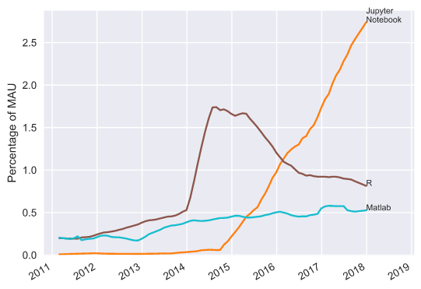
R is an open source language
https://www.benfrederickson.com/ranking-programming-languages-by-github-users/

Slide 5

R Studio is a tailored IDE for R

Slide 6


R Studio is a tailored IDE for R… & python

Slide 7

R Studio is a tailored IDE for R… & python

Slide 8
Lets first download
https://www.r-project.org/
Navigate to the CRAN link on the left
Select a UK mirror
Click download for the machine you use

Slide 9
Now lets download
https://posit.co/
Navigate to ‘download R Studio’
Click the free/Desktop version

Slide 10

Lets download some code to explore R
https://github.com/josephmbarnby
Go to the ‘BeginR’ link
Click ‘code’ and download the ZIP
Open Intro_to_script_features.R in Rstudio

Slide 11
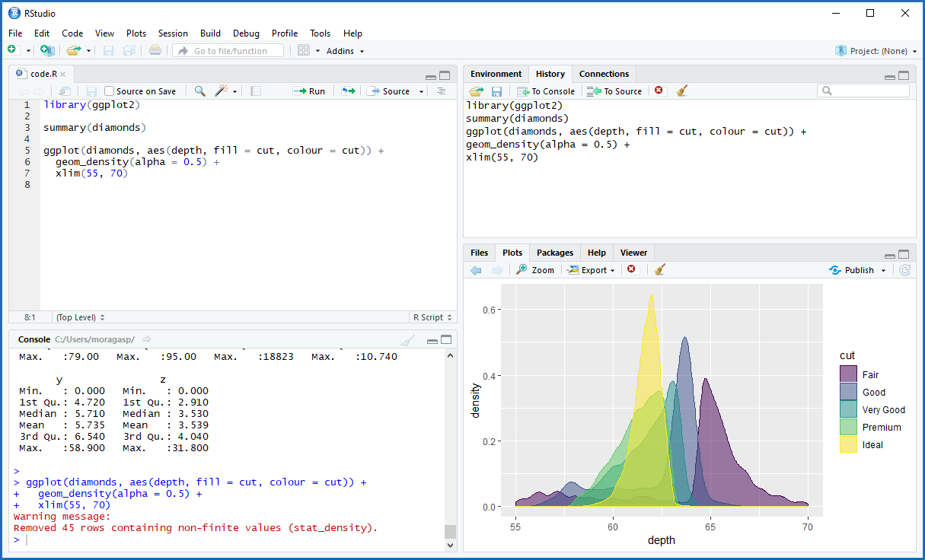
Lets take a look at the interface…

Slide 12
Lets look at the code and work through the script

Slide 13
Quick Quiz
What does this mean? How many dimensions does this have?
myvar[1]

Slide 14
Quick Quiz
What does this mean? How many dimensions does this have?
myvar[,1]

Slide 15
Quick Quiz
What does this do?
xyz <- myvar[,1]

Slide 16
This lecture…

Slide 17

This lecture…

Slide 18

This lecture…
Cleaning
Analysis

Slide 19
Our data….

Slide 20
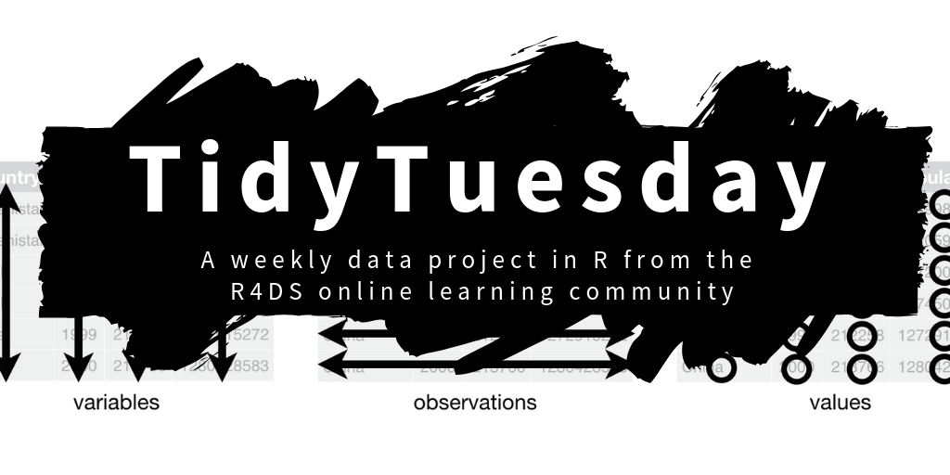
Our data….
https://github.com/rfordatascience/tidytuesday

Slide 21
Our data….

Slide 22
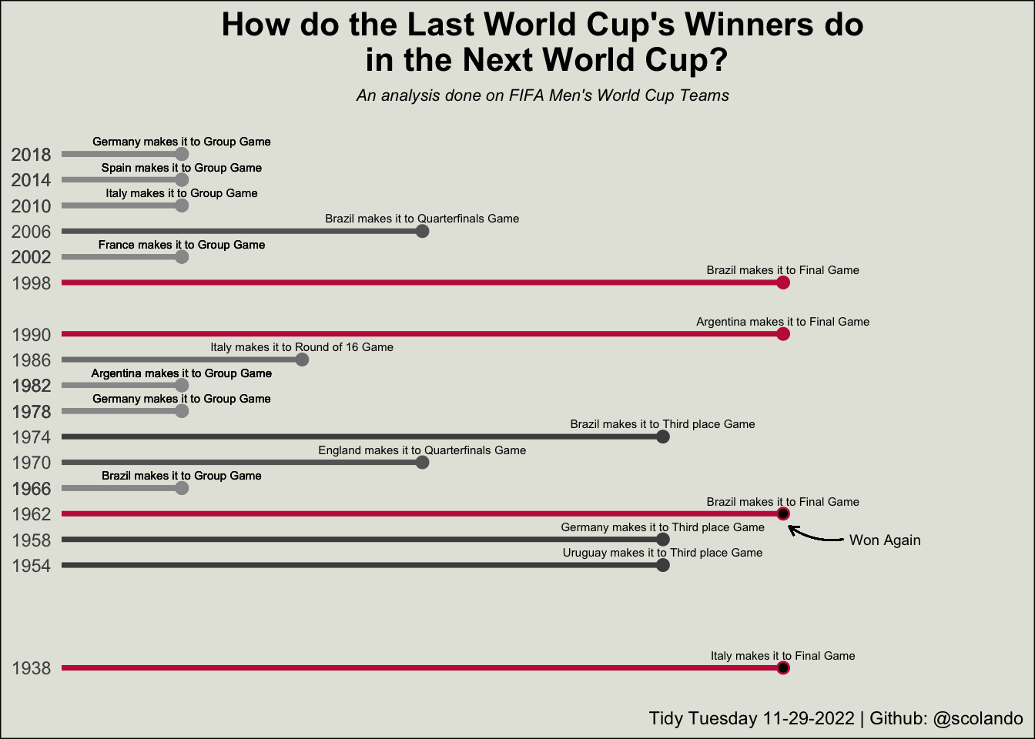

Slide 23


Lets get stuck in….

